Slide 1
The Principles You Need to Know (and those you should forget)
David Sackstein

Slide 2
Overview
In this module we will review the most essential principles of software design.
Building on these, we will review the three pillars of OOD. Encapsulation, inheritance and polymorphism. Do we actually need them and why?
We will engage in an open discussion and the conclusions will be demonstrated with code examples. The examples will demonstrate common pitfalls, the techniques you can use to identify the problems, and how to fix them using simple C++.

Slide 3
Agenda
Our single biggest problem: Complexity
The principles you need to know
The Single Responsibility Principle
The Open Closed Principle
Encapsulation
Prefer Composition over Inheritance
System Organization and Refactoring
What you should forget
Inheritance

Slide 4
The Crux of the Matter
Dependencies are our biggest problem
The solution is to break large solutions into smaller components that:
Have one responsibility
Have a clear and concise interface
Have tests that use the interface
Use a small number of components
Only use the public interface of other components

Slide 5
Causes of Complexity
Too many dependencies between components (coupling)
Components with too many responsibilities
Components that are large
Components with unclear usage contracts
Components that expose implementations
And, of course, laziness: Quick and dirty changes that cause the above

Slide 6
Benefits of reduced complexity
Testability
Components with a single responsibility and a clear contract can easily be held responsible.
Extensibility
Abstractions are extension points. New implementations do not affect other components.
Readability
Smaller, isolated functionality is easier to reason about

Slide 7
Benefits of reduced complexity
Maintainability
Easier to read is easier to understand.
Easier to test is safer to change without regression.
Reusability
Components with fewer dependencies carry less “baggage”.
Components with a clear contract are easier to “sell”.

Slide 8
The Principles You Need to Know
The Single Responsibility Principle
Encapsulation
Prefer Composition over Inheritance
The Open Closed Principle
Immutability is your friend
System Organization and Maintenance

Slide 9
The Single Responsibility Principle
Classes and methods should have only one responsibility.
Classes and methods should have only one reason to change.
One file should contain only one class
SRP classes and methods are easier to understand and test.
Try to state the responsibility without using the word “and”.

Slide 10
The Single Responsibility Principle
Each file, class, function, library should have one responsibility.
Responsibilities can often be measured in size:
File < 200 lines
Function < 15 lines
Class header < 50 lines
Class source < 200 lines
But these are not enough

Slide 11
The Single Responsibility Principle
A good indication of SRP violations is a lack of cohesiveness.
A cohesive class is one in which most fields are used referenced by most methods.
An island of associated fields and methods should really be a class in itself.
Extract islands as classes.

Slide 12
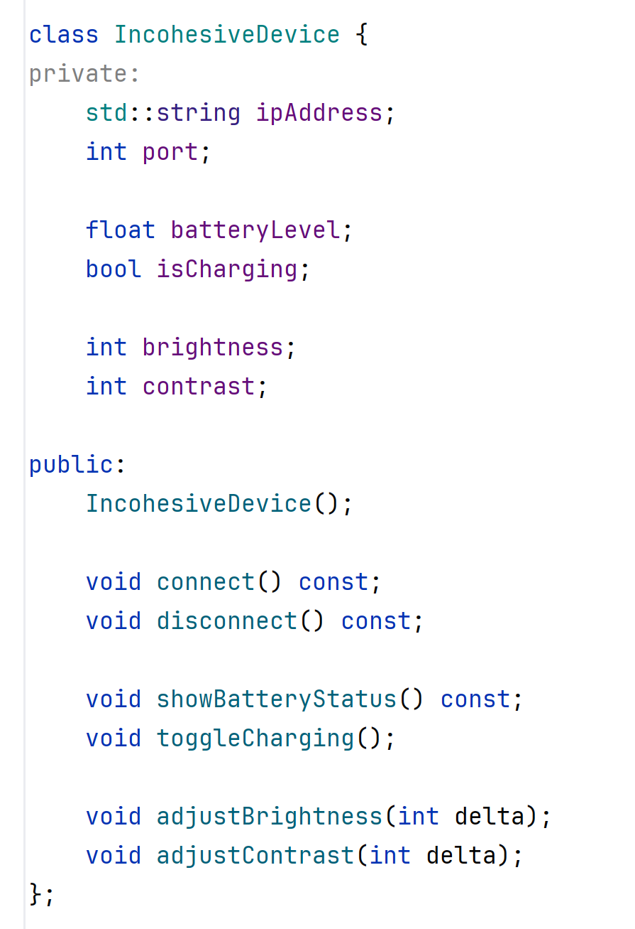
Connectivity
Battery
Display
IncohesiveDevice has three responsibilities and three islands of fields and methods

Slide 13
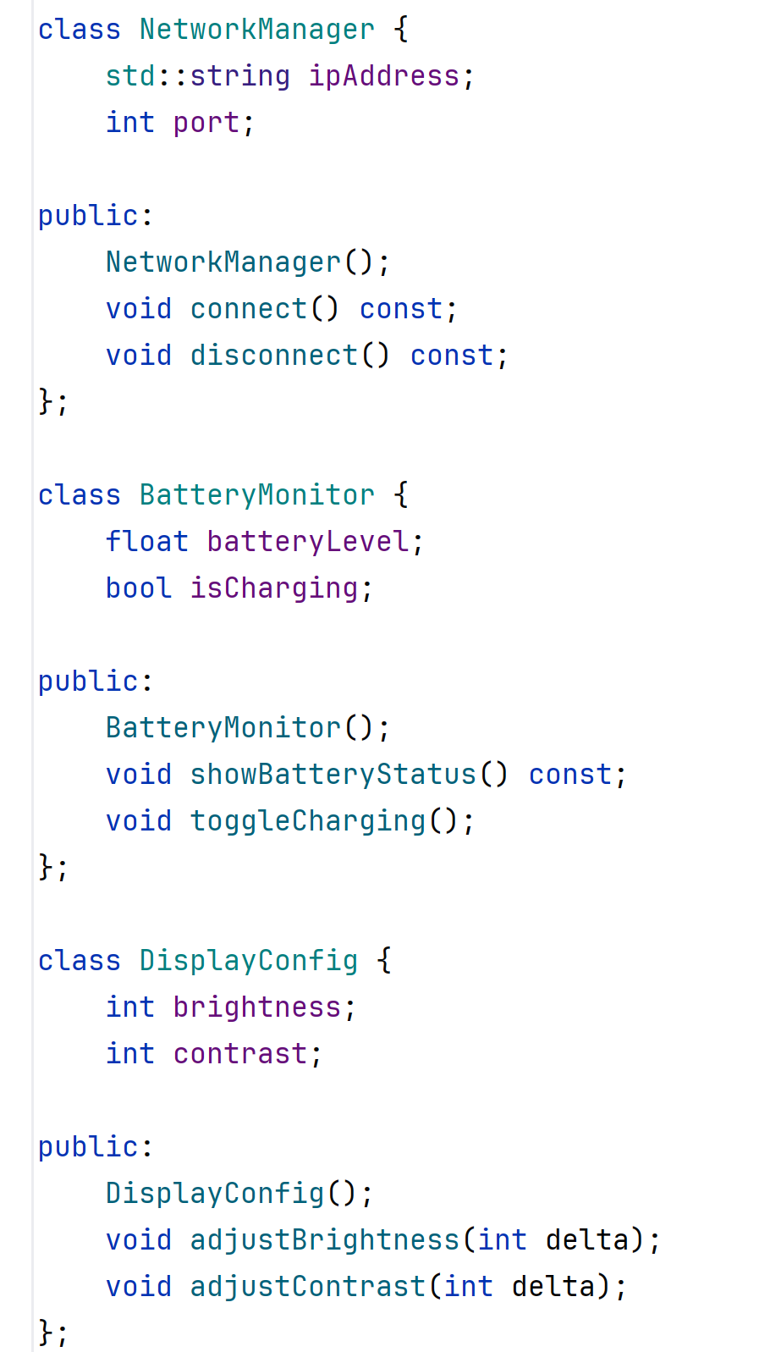
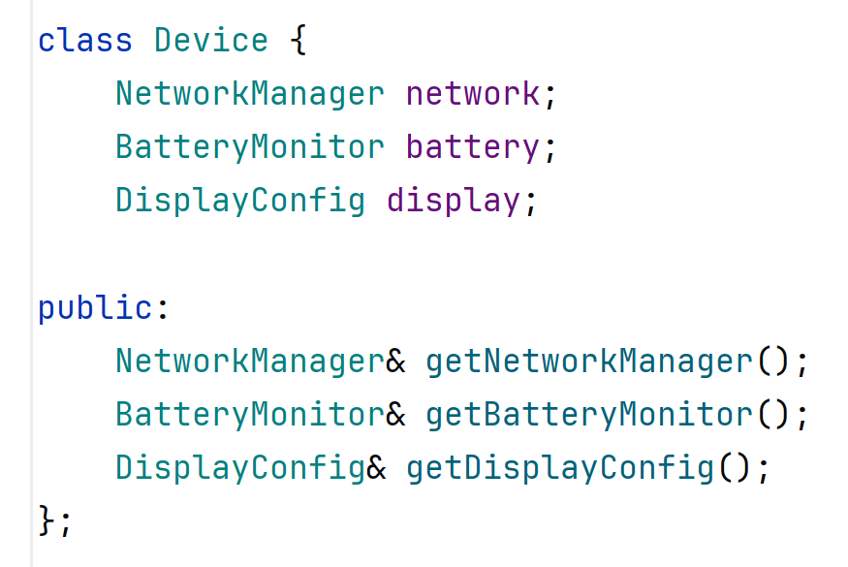
Device is a manager of objects, each with a single responsibility

Slide 14
Encapsulation
The Three Pillars of Object Oriented Design
Encapsulation
Polymorphism
Inheritance
Which do we need and which should we avoid?
Encapsulation is the most important
Polymorphism helps achieve encapsulation
Inheritance (code reuse) undermines encapsulation

Slide 15
Two types of inheritance
Polymorphism: Inheritance of contract
A commitment by the implementor
A capability a consumer can depend on
Code Reuse: Inheritance of implementation
Derived classes call methods of their base class
Template method: The base class also calls virtual methods of the derived class.

Slide 16
Polymorphism: Benefits
Encapsulation: Users of the interface cannot see the implementation
Programming by contract: Users of the interface can clearly see the contract
Benefits of encapsulation:
Testability: Replacement of implementations using mocks.
Extensibility: Upgrading implementations without rebuilding the caller.

Slide 17
Polymorphism: Pitfalls
Encapsulation: Users of the interface cannot see the implementation
This may make it difficult to fully understand the code, but not really
It’s a trade-off (is decoupling good or bad?)
Caller code should be easier to understand if the implementations are hidden
But there is such a thing as over abstraction

Slide 18
Code Reuse: Benefits
Avoids code duplication by:
Moving common code into the base class
Moves varying code into derived classes
It’s so easy! You can call the implementation without specifying the name of an object

Slide 19
Code Reuse: Pitfalls
It introduces coupling between the derived class and the base class:
Includes of the derived’s header must also include the header of the base.
The size of the derived class depends on the size of the base. So, if the base changes you need to recompile. (No runtime compatibility)
May introduce cyclic dependencies, because the base class can call the derived class and vice versa
Effectively the base and the derived classes are one big class split across multiple files.

Slide 20
Code Reuse: Pitfalls
It breaks encapsulation
The derived class has access to all public members of the implementation class.
It’s like marking your implementation fields and methods public.
All members of all base classes are in the same namespace and can be confused without warning (the diamond problem)
It limits testability of the derived class
The implementation in the base class cannot be replaced by a mock in a test
Coupled classes can only be tested together
It limits reusability of the derived class
The derived class can only be reused if the implementation provided in the base class is desired

Slide 21
And it gets worse
Often, inheritance is used to achieve both goals (polymorphism and code reuse)
A glorious violation of the Single Responsibility Principle
This complicates the class giving it multiple responsibilities.
The relationship between base and derived are not clear making it difficult to maintain
Large inheritance hierarchies are difficult to maintain
When implementations change, inheritance relationships are required to change.

Slide 22
Summary so far
Inheritance of Contract: Good
Inheritance of Implementation: Bad
Exception: Data classes can use inheritance because:
We don’t test data classes
There are no methods in data classes, so no cycles
Data class expose all their data as public. No need for encapsulation

Slide 23
Prefer Composition over Inheritance
For code reuse – use composition
Everywhere you use inheritance today you can use composition:
When derived class uses the base class
The base class becomes a member
When base class uses derived class
The derived class becomes a member

Slide 24
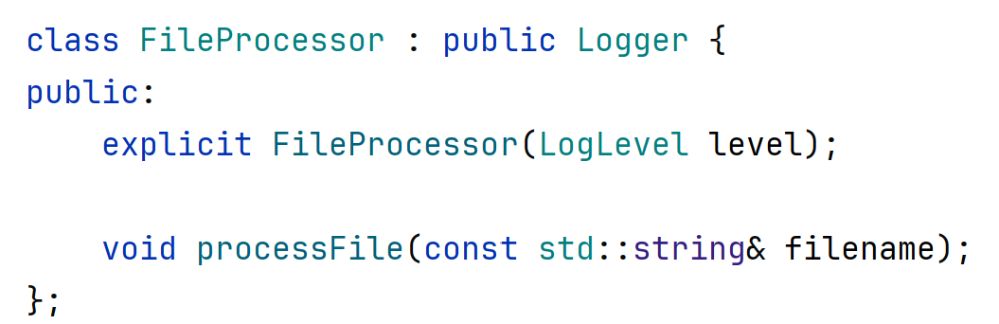
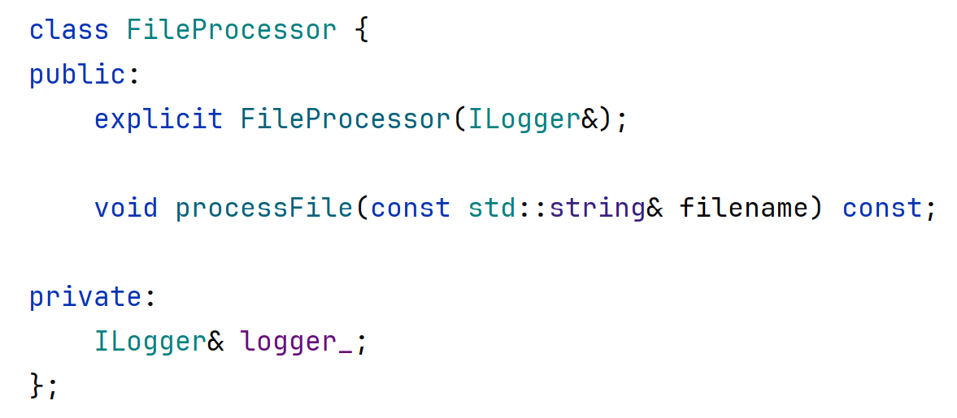
Base class becomes a member

Slide 25
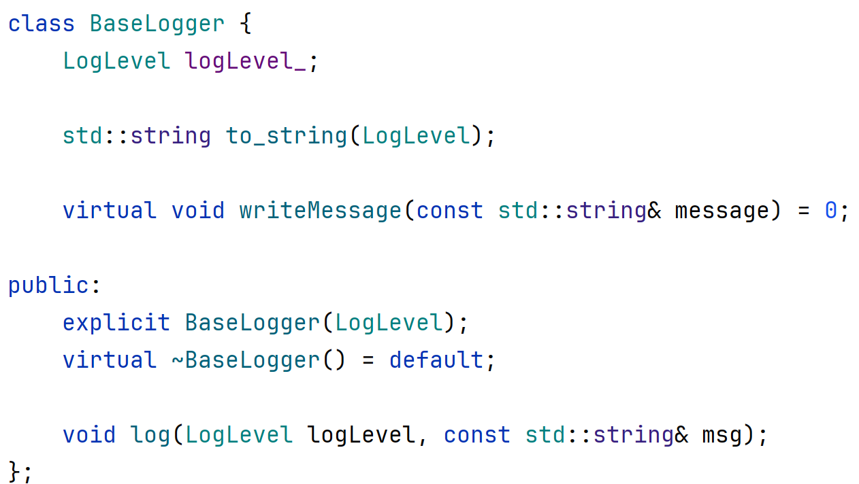
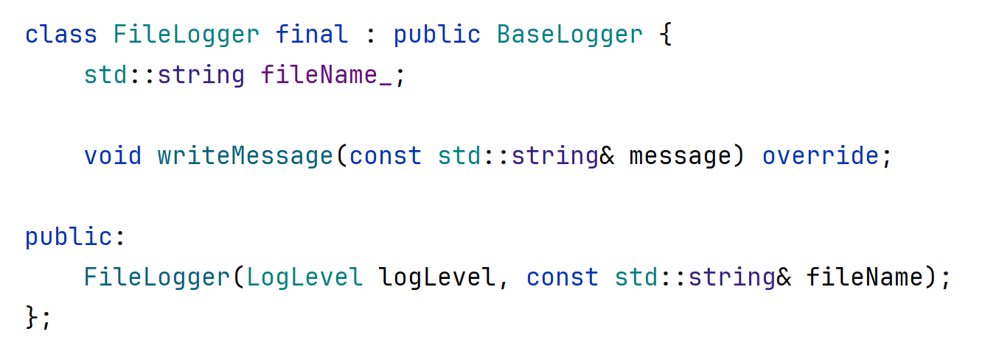
Derived class becomes a member

Slide 26
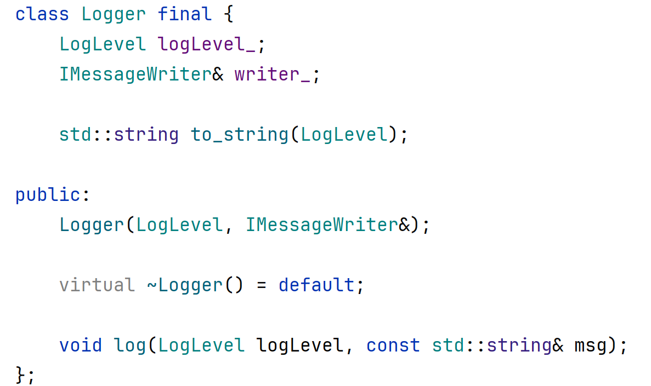
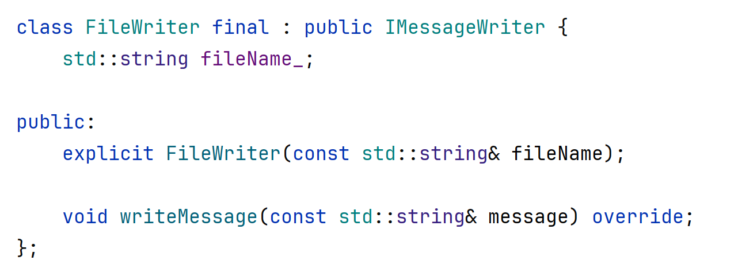
Derived class becomes a member

Slide 27
The Open Closed Principle
A design should be Open for extension and Closed for modification.
That is, adding new functionality should not require changing existing functionality.
Do not add empty interface methods that are not required today.
But do use abstractions to simplify extending later.

Slide 28
Immutability is your friend
An immutable class cannot be modified
This means that you only need to see its constructor to know its state.
This reduces complexity and simplifies debugging
Functional programming languages force immutability (copy on write).

Slide 29
Immutability is your friend
C++ is not strictly a functional programming language.
It is an object-oriented language which typically uses mutation of state.
However, it is recommended to prefer immutable fields where possible.
Dependencies, for instance should not be modified during the lifetime of an object.

Slide 30
System Organization
Divide large projects into small components.
Each component should have only one responsibility.
Express the responsibility by a simple contract.
Encapsulation: hide implementation details.
Abstraction: allows interchangeability of components

Slide 31
Refactoring
When adding new functionality, favor creating a new class (and file)
When a function or class grows to big, extract methods and classes.
Use (and add) tests to ensure there are no regressions.

